Slide 1



ice sheet models for exoplanets
Alexandra Rochon
Trottier Space Institute Summer Intern, McGill University
Supervised by Prof. Natalya Gomez, Dr. Thomas Navarro, Prof. Nicolas Cowan

Slide 2
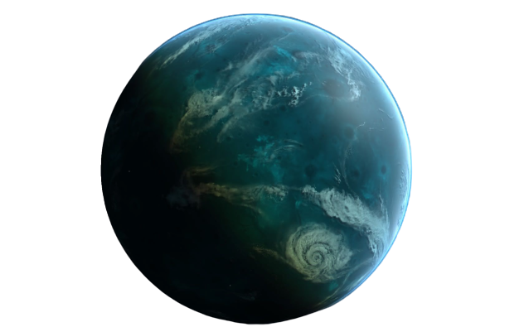
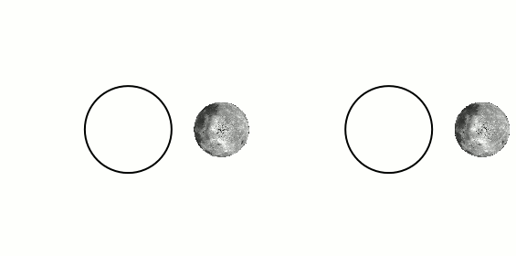
Exoplanet climate
Water worlds
Tidal Locking
Stigmatella aurantiaca - Wikipedia
Notes:
When we look for exoplanets as a potentially habitable place, where we could find life, we look for them in the “habitable zone” of their star. This is the specific orbital distance that would provide sufficient light from the star for the planet to be warm enough to have liquid water at its surface.
And we know that low mass stars are the most common in the galaxy, so we believe most exoplanets can be found orbiting those.
For low mass stars, this zone is very close to the star. So, the planet would have a very short orbit.
We believe that when exoplanets orbit close enough to their host star, they are often in an orbital configuration called “tidal locking”. This synchronous rotation results in a permanent dayside that constantly receives flux from the star and a cold and dark nightside, like the moon.

Slide 3
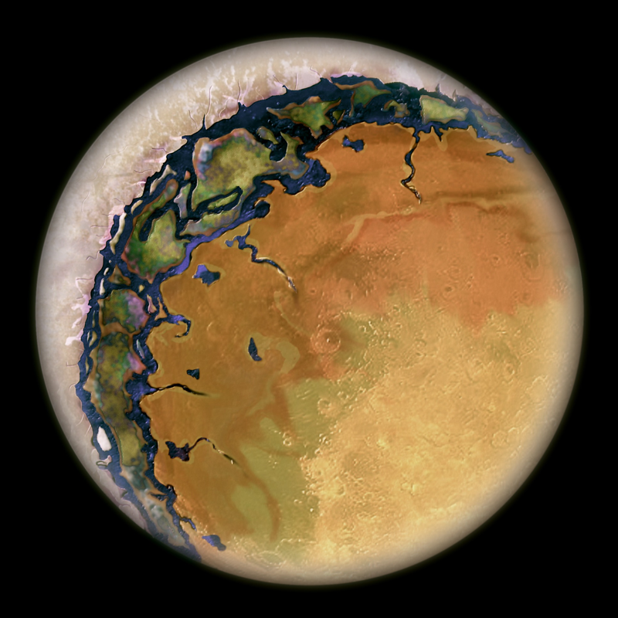
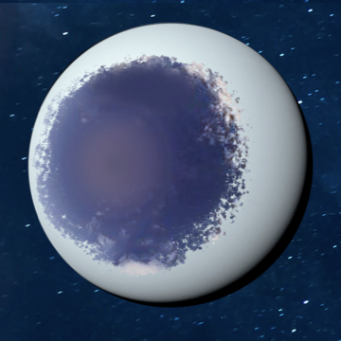
How does Tidal locking affect the climate and availability of liquid water?
“Eyeball” climate state
Ice caps on poles and nightside
Dry dayside
Open ocean at substellar point
Yang et al. 2021, Beau.TheConsortium/Rare Earth Wiki
Notes:
We think that for planets with liquid water at their surface, tidal locking results in an eyeball climate state for planets with liquid water at the surface, where we expect open ocean at the substellar point and polar ice caps and nightside coverage with very high ice thickness, but not a complete snowball planet when it is completely rotating.
It could also be that the open ocean has completely evaporated leaving a dry dayside and trapping water as ice on the cold nightside.
So, we build models to test what scenarios or climate states are most plausible. For my project, I looked at water worlds with a floating ice shell and considered how ice dynamics, and the fact that ice flow like a fluid, might affect the stability of this system. and how available liquid water is in those climates.
Other parameters: sea-ice drift, ocean heat transport,
in iREx – mention previous works in more details
explain ice dynamics
log B for for ice flow in irex talk
Known waterworld /ocean covered + ice covered moons in the solar system
see if I can add more possible climate state and that’s why we run simulations

Slide 4
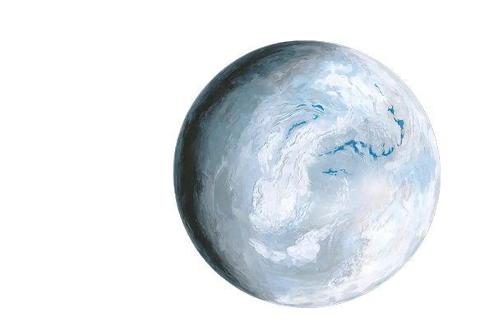
Numerical modelling
1. Used a Snowball Earth model from Tziperman et al. (2012)
Richard Bizley/Science Photo Library
Notes:
So in order to do that, I used a numerical model that was developed by Tziperman et al. in 2012 to study the ice thickness on Snowball Earth with a continental configuration of 630 Ma Earth. We chose this unique ice flow model because it it is two-dimensional and in spherical coordinates.
We modified the model to represent tidally locked exoplanets by removing the continental parameters to focus on an ocean world and changing the temperature profile to represent a tidally-locked system. We then decided to couple the model with a Global Climate model.
the gcm predicts tsurf and ice thickness as input for ice flow model
using that as input the ice model predicts how the evolves
The Global Climate Model provides initial parameters for the ice flow model, including a map of surface temperature and initial ice thickness. We can then use the ice flow model which accounts for ice dynamics parameter to see how the ice evolves and if the system is stable.
change plot for snowball earth representation and add here what I did
modify all axes
unique model
GCM coupling implementation is new
on a decicde de coupler les modeles

Slide 5
Numerical modelling
1. Used a Snowball Earth model from Tziperman et al. (2012)
2. Modified for tidally locked exoplanets
Constrained initial parameters with GCM input
Replace continent mask with ice-free ocean mask
2D surface temperature profile
netCDF model output to couple with GCM
Richard Bizley/Science Photo Library
Notes:
So in order to do that, I used a numerical model that was developed by Tziperman et al. in 2012 to study the ice thickness on Snowball Earth with a continental configuration of 630 Ma Earth. It is a unique 2D global model for ice flow as it was written in spherical coordinates.
We modified the model to represent tidally locked exoplanets by removing the continental parameters to focus on an ocean world and changing the temperature profile to represent a tidally-locked system. We then decided to couple the model with a Global Climate model.
So in order to do that, I used a numerical model that was developed by Tziperman et al. in 2012 to study the ice thickness on Snowball Earth with a continental configuration of 630 Ma Earth. We let go of the continental parameters to focus on an ocean world and changed the temperature profile to represent a tidally-locked system.
RICHARD BIZLEY/SCIENCE PHOTO LIBRARY
the gcm predicts tsurf and ice thickness as input for ice flow model
using that as input the ice model predicts how the evolves
The Global Climate Model provides initial parameters for the ice flow model, including a map of surface temperature and initial ice thickness. We can then use the ice flow model which accounts for ice dynamics parameter to see how the ice evolves and if the system is stable.
change plot for snowball earth representation and add here what I did
modify all axes
unique model
GCM coupling implementation is new
on a decicde de coupler les modeles

Slide 6
Numerical modelling
1. Used a Snowball Earth model from Tziperman et al. (2012)
3. Coupled to a model to predict initial parameters
3D Global Climate Model (GCM) (Turbet 2016)
Spherical 2D Ice Flow Model (Tziperman 2012)
Surface Temp.
Ice thickness
2. Modified for tidally locked exoplanets
Constrained initial parameters with GCM input
Replace continent mask with ice-free ocean mask
2D surface temperature profile
netCDF model output to couple with GCM
Richard Bizley/Science Photo Library
Notes:
So in order to do that, I used a numerical model that was developed by Tziperman et al. in 2012 to study the ice thickness on Snowball Earth with a continental configuration of 630 Ma Earth. It is a unique 2D global model for ice flow as it was written in spherical coordinates.
We modified the model to represent tidally locked exoplanets by removing the continental parameters to focus on an ocean world and changing the temperature profile to represent a tidally-locked system. We then decided to couple the model with a Global Climate model.
The GCM predicts the surface temperature and ice thickness to be used as input for the ice flow model.
The model uses this input to calculate how ice evolves using the temperature dependance of ice viscosity and calculating the ice velocity vectors.

Slide 7
the surface temperature profile
Tidally Locked
Coldest zone at the pole
Hottest zone at substellar point (dark red)
Eyeball feature
Color bar: temperature (K)
Fully rotating
Initial temperature profile
Longitudinal average
For Snowball Earth
Notes:
This is a comparison between the tidally locked surface temperature profile and how the flux received by the planet differs.
The black represent areas of minimal ice coverage as well as the open ocean.
This shows how tidal locking affects the ice flow and the stability of the climate.
We compare the effect of the tidal locking climate on ice evolution. Both simulation had with the same initial ice elevation.

Slide 8
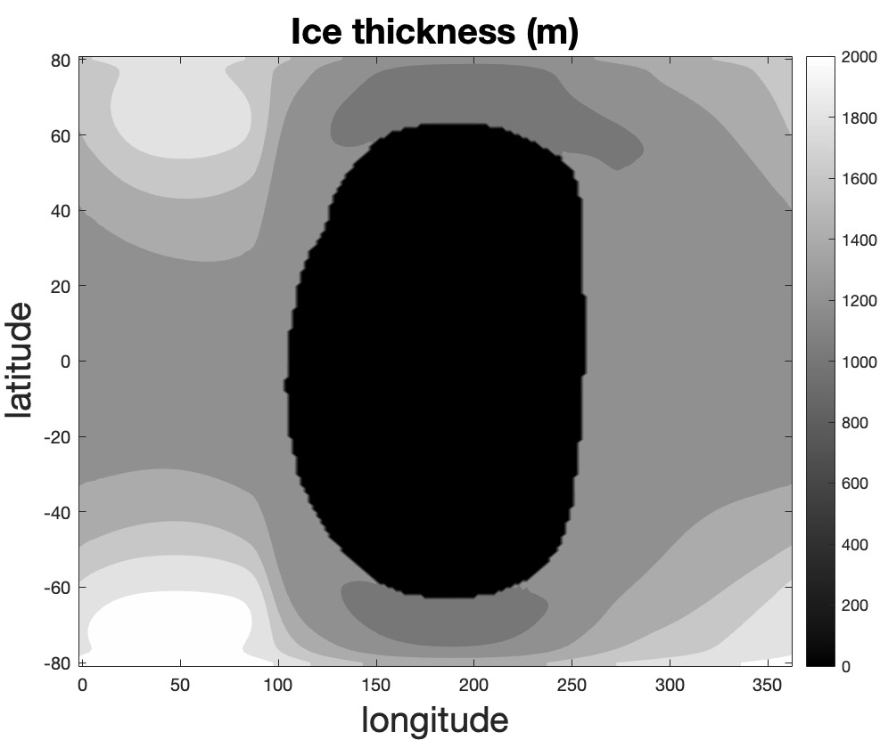
the surface temperature profile
Tidally Locked
Coldest zone at the pole
Hottest zone at substellar point (dark red)
Eyeball feature
Color bar: temperature (K)
Fully rotating
Initial temperature profile
Longitudinal average
For Snowball Earth
Notes:
This is a comparison between the tidally locked surface temperature profile and how the flux received by the planet differs.
The black represent areas of minimal ice coverage as well as the open ocean.
This shows how tidal locking affects the ice flow and the stability of the climate.
We compare the effect of the tidal locking climate on ice evolution. Both simulation had with the same initial ice elevation.

Slide 9
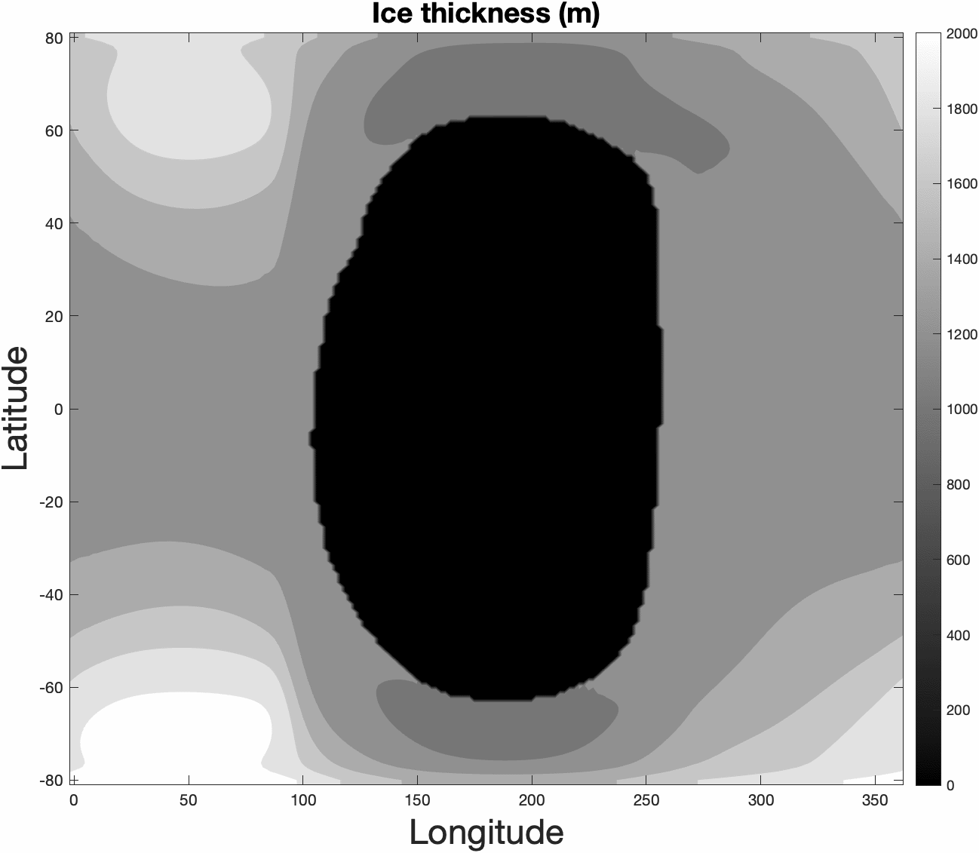
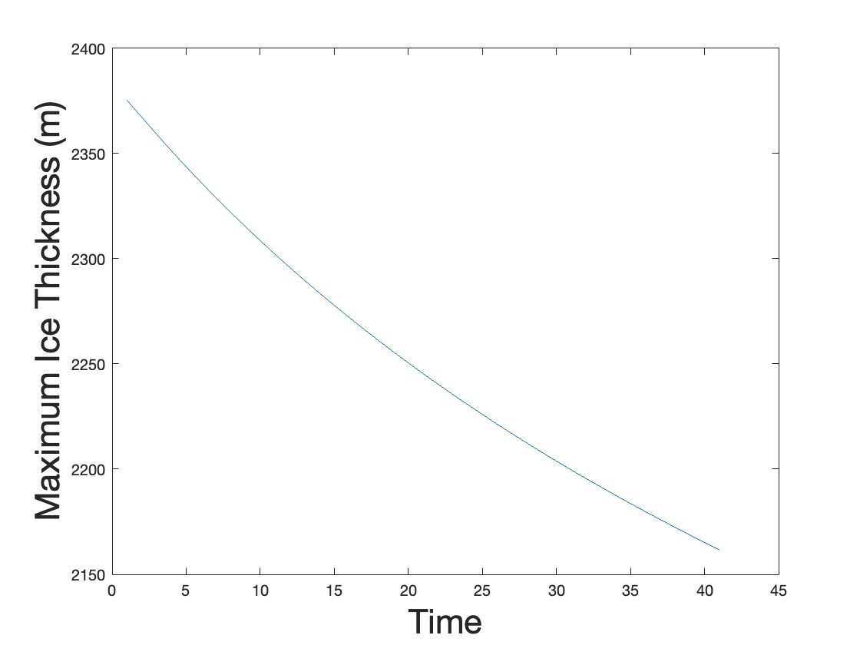
reaching steady state
Convergence of Maximum Ice Thickness
Ice elevation (m) change with time
Black: Ice free ocean
Notes:
So, this is a representation of how ice (in white) is evolving in the model.
The poles are melting and ice is accumulating on the nightside
We use a convergence plot to determine if steady state was reached. This is done by taking the maximum ice elevation at each time step. We expect the trend to flatten out which is not yet happening on this slide. We know that as a next step, the model needs to run for much longer than the current trials which last about 8 hours.
Ice thickness
Steady state of ice flow
Ideally this slide has a gif of the evolution of each plot
initial vs final
animation
change colorscheme
list of all steps I made
slide on the physics for irex

Slide 10
key takeaways
“Eyeball” climate state
Availability of liquid water
Ice flow and model coupling
Open ocean at the substellar point
Notes:
So, to recap what we discussed, we saw that tidally locked exoplanets, which we think are very common, are in an “eyeball”-like climate state and this brings up question about the availability of liquid water at the surface.
While there are multiple parameters to consider when building models to answer this question, we focused on ice dynamics and we adapted an existing model to tidal locking scenario and coupled it with a global climate model for exoplanet. The eyeball climate state has polar and nightside ice coverage and an open ocean at the substellar point. Longer simulations reaching steady state are necessary to say more about the availability of liquid water. We now have a functional model to do so.
To make the models more realistic, a next step is to consider that the ice shell of the planet would be an ice sheet covering continents, which changes the behavior of ice.
The model also currently uses a static mask for the open ocean as it doesn’t handle zero ice elevation, so an important implementation will be to allow the mask to change shape.
Finally, the model needs to be fully coupled to the GCM.
make it visual what is gonna change
recap parameter interactions are important we looked at a few, and present a current state from these and compare this with theory
first order parameter but can get closer to a more realistic model, add layers
colums+images
to study the stability of the climate on ice-covered water world.
GCM proxima centauri b avec eau sur terre et atmosphere

Slide 11
key takeaways
Next Steps
Changing open ocean mask
“Eyeball” climate state
Availability of liquid water
Ice flow and model coupling
Open ocean at the substellar point
Notes:
So, to recap what we discussed, we saw that tidally locked exoplanets, which we think are very common, are in an “eyeball”-like climate state and this brings up question about the availability of liquid water at the surface.
While there are multiple parameters to consider when building models to answer this question, we focused on ice dynamics and we adapted an existing model to tidal locking scenario and coupled it with a global climate model for exoplanet. The eyeball climate state has polar and nightside ice coverage and an open ocean at the substellar point. Longer simulations reaching steady state are necessary to say more about the availability of liquid water. We now have a functional model to do so.
To make the models more realistic, a next step is to consider that the ice shell of the planet would be an ice sheet covering continents, which changes the behavior of ice.
The model also currently uses a static mask for the open ocean as it doesn’t handle zero ice elevation, so an important implementation will be to allow the mask to change shape.
Finally, the model needs to be fully coupled to the GCM.
make it visual what is gonna change
recap parameter interactions are important we looked at a few, and present a current state from these and compare this with theory
first order parameter but can get closer to a more realistic model, add layers
colums+images
to study the stability of the climate on ice-covered water world.
GCM proxima centauri b avec eau sur terre et atmosphere

Slide 12
key takeaways
Next Steps
Changing open ocean mask
Account for bedrock and continents
“Eyeball” climate state
Availability of liquid water
Ice flow and model coupling
Open ocean at the substellar point
Notes:
So, to recap what we discussed, we saw that tidally locked exoplanets, which we think are very common, are in an “eyeball”-like climate state and this brings up question about the availability of liquid water at the surface.
While there are multiple parameters to consider when building models to answer this question, we focused on ice dynamics and we adapted an existing model to tidal locking scenario and coupled it with a global climate model for exoplanet. The eyeball climate state has polar and nightside ice coverage and an open ocean at the substellar point. Longer simulations reaching steady state are necessary to say more about the availability of liquid water. We now have a functional model to do so.
To make the models more realistic, a next step is to consider that the ice shell of the planet would be an ice sheet covering continents, which changes the behavior of ice.
The model also currently uses a static mask for the open ocean as it doesn’t handle zero ice elevation, so an important implementation will be to allow the mask to change shape.
Finally, the model needs to be fully coupled to the GCM.
make it visual what is gonna change
recap parameter interactions are important we looked at a few, and present a current state from these and compare this with theory
first order parameter but can get closer to a more realistic model, add layers
colums+images
to study the stability of the climate on ice-covered water world.
GCM proxima centauri b avec eau sur terre et atmosphere

Slide 13
key takeaways
Next Steps
Changing open ocean mask
Account for bedrock and continents
Fully coupled GCM
“Eyeball” climate state
Availability of liquid water
Ice flow and model coupling
Open ocean at the substellar point
Ice Flow Model
Global Climate Model
Ice thickness
Surface Temp.
Ice thickness
Notes:
So, to recap what we discussed, we saw that tidally locked exoplanets, which we think are very common, are in an “eyeball”-like climate state and this brings up question about the availability of liquid water at the surface.
While there are multiple parameters to consider when building models to answer this question, we focused on ice dynamics and we adapted an existing model to tidal locking scenario and coupled it with a global climate model for exoplanet. The eyeball climate state has polar and nightside ice coverage and an open ocean at the substellar point. Longer simulations reaching steady state are necessary to say more about the availability of liquid water. We now have a functional model to do so.
To make the models more realistic, a next step is to consider that the ice shell of the planet would be an ice sheet covering continents, which changes the behavior of ice.
The model also currently uses a static mask for the open ocean as it doesn’t handle zero ice elevation, so an important implementation will be to allow the mask to change shape.
Finally, the model needs to be fully coupled to the GCM.
make it visual what is gonna change
recap parameter interactions are important we looked at a few, and present a current state from these and compare this with theory
first order parameter but can get closer to a more realistic model, add layers
colums+images
to study the stability of the climate on ice-covered water world.
GCM proxima centauri b avec eau sur terre et atmosphere

Slide 14
Acknowledgement
I thank Professor Natalya Gomez and Dr. Thomas Navarro for their support and expertise during this project, as well as the Trottier Space Institute at McGill and the Trottier family for the opportunity.
Notes:
So I’m gonna go over my project and the main concepts. I’m still learning and getting more familiar, especially with understanding ice sheets flow, so I’ll mostly walk you through
My project is to study the transport of water in tidally locked exoplanets by ultimately coupling a global climate model and an ice flow model.
Exoplanets orbiting stars closely are often found in tidal locking, this means permanent dayside / nightside. This is due to gravitational interactions that force the planet into synchronous rotation s.t. a rotation on itself takes as long as an orbit around its star.
Creates very strong temperature contrast between dayside / nightside. So we are interested in what happens to a planet with liquid water at its surface
Could have ocean covered planet, water evaporation, significant ice sheet coverage on the nightside that could become water cold traps
So a planet with a significant water reservoir and temperature that allows for liquid water somewhere on its surface could have essentially not available liquid water
Become very dry
The reason why this is relevant research in the current context is that
1) Most likely type of orbital configuration to find around red dwarfs (most common stars), low luminosity, low mass, active stars
Because they are so small, the habitable zone (where we can hope to find liquid water) is much closer to the star, so the planet is most likely to be trapped in synchronous rotation.
2) None of the current models tackle this problem. The way we go about it is to adapt a 2D global ice flow model published by Tziperman et al in 2012 that studied the snowball earth paleoclimate to move from earth-centric parameters to assumptions appropriate for exoplanets in a tidally locked system. Ultimately we want to effectively couple this model with a global climate model
Ice-sheet models use numerical methods to simulate the evolution, dynamics and thermodynamics of ice sheets

Slide 15
key takeaways
Next Steps
Changing open ocean mask
Account for bedrock and continents
Fully coupled GCM
“Eyeball” climate state
Availability of liquid water
Ice flow and model coupling
Open ocean at the substellar point
Global Climate Model
Ice Flow Model
Ice thickness
Surface Temp.
Ice thickness
Notes:
So, to recap what we discussed, we saw that tidally locked exoplanets, which we think are very common, are in an “eyeball”-like climate state and this brings up question about the availability of liquid water at the surface.
While there are multiple parameters to consider when building models to answer this question, we focused on ice dynamics and we adapted an existing model to tidal locking scenario and coupled it with a global climate model for exoplanet. The eyeball climate state has polar and nightside ice coverage and an open ocean at the substellar point. Longer simulations reaching steady state are necessary to say more about the availability of liquid water. We now have a functional model to do so.
To make the models more realistic, a next step is to consider that the ice shell of the planet would be an ice sheet covering continents, which changes the behavior of ice.
The model also currently uses a static mask for the open ocean as it doesn’t handle zero ice elevation, so an important implementation will be to allow the mask to change shape.
Finally, the model needs to be coupled
This is going to happen in the near future.
make it visual what is gonna change
recap parameter interactions are important we looked at a few, and present a current state from these and compare this with theory
first order parameter but can get closer to a more realistic model, add layers
colums+images
to study the stability of the climate on ice-covered water world.
GCM proxima centauri b avec eau sur terre et atmosphere

Slide 16
Model Specifics
GCM
3D global
Atmospheric radiative transfer
26 atmospheric layers
18 soil layers
Ice flow model
2D global spherical coordinates
Shallow Shelf Approximation (SSA)
Infinitely deep ocean
Implementations
Constrained initial parameters with GCM input
Replaced continent mask with ice-free ocean mask
2D surface temperature profile
netCDF model output to couple with GCM
Notes:
GCM accounts for bolometric albedo of ice around an M-dwarf, radiative effects of clouds, Rayleigh scattering. No oceanic heat transport
Ice flow model uses an infinitely deep ocean, allows ice to grow arbitrarily. Uses shallow ice approximation, ignores many known important factors such as thermodynamic, optical effects, dust and dust transport, and is therefore meant as a process study focusing on one specific effect, rather than a realistic simulation
do not differentiate between surface and basal melting/freezing, and therefore do not include feedbacks between basal melting/ freezing and ice thickness

